Slide 1

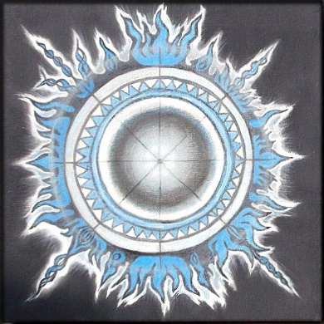
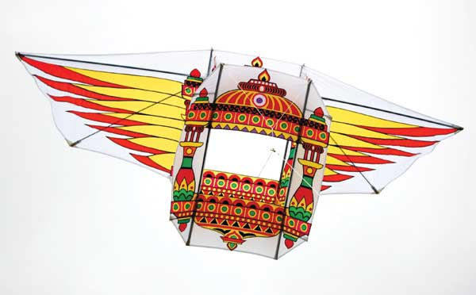
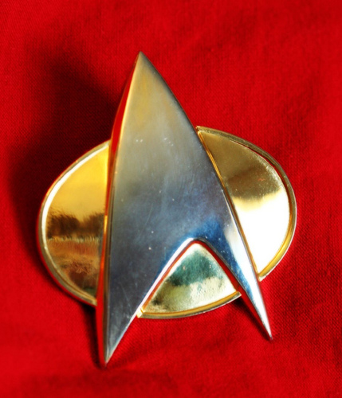
Algorithms for Intelligent Devices
Resource Constrained Machine Learning in a Few Kilobytes of RAM
Manik Varma & Prateek Jain
Microsoft Research India

Slide 2

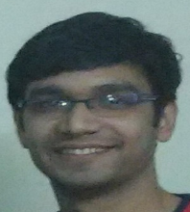
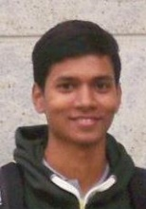


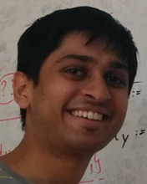
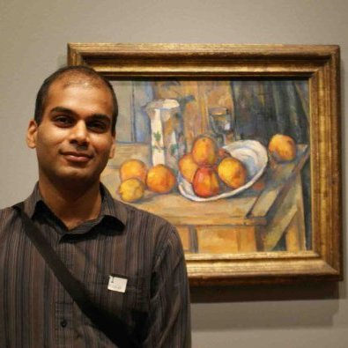
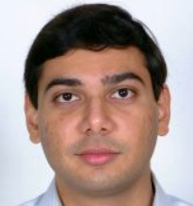

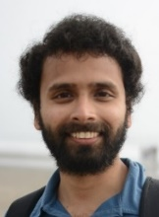

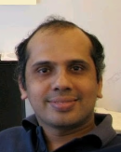
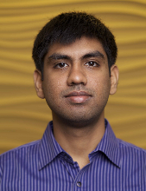
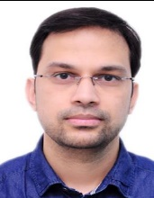


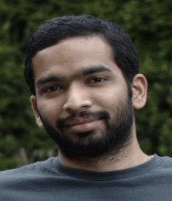
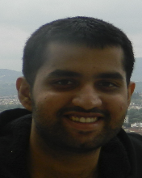
Ajay
Manchepalli
Ankit
Goyal
Arun Sai
Suggala
Ashish
Kumar
Bhargavi
Paranjape
Chirag
Gupta
Harsha Vardhan
Simhadri
Manik
Varma
Nagarajan
Natarajan
Praneeth
Netrapalli
Prateek
Jain
Raghavendra
Udupa
Rahul
Sharma
Saurabh
Goyal
Shruti
Bhargava
Suresh
Parthasarathy
Vivek
Seshadri
Yeshwanth
Cherapanamjeri

Slide 3
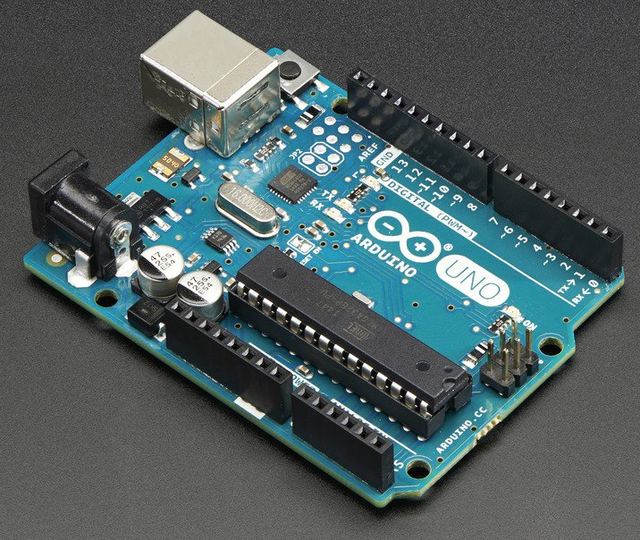
The Arduino Uno
8 bit ATmega328P Processor at 16 MHz
with 2 KB RAM & 32 KB read only Flash

Slide 4
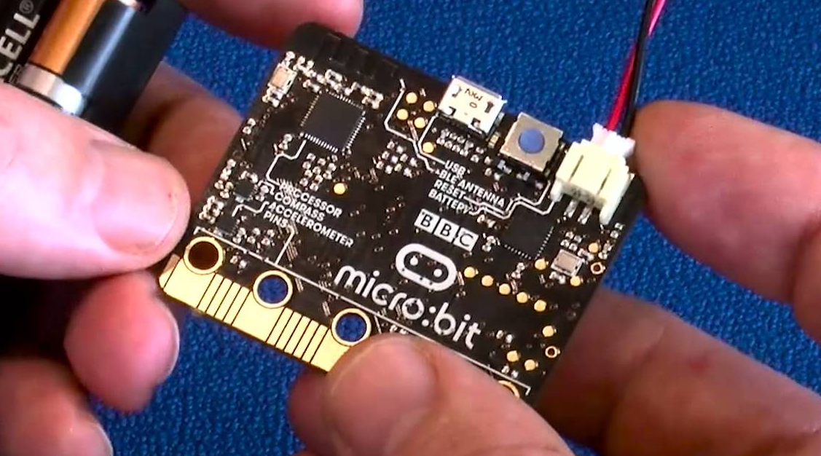
The BBC Micro:Bit
32 bit ARM Cortex M0 Processor at 16 MHz
with 16 KB RAM & 256 KB read only Flash

Slide 5

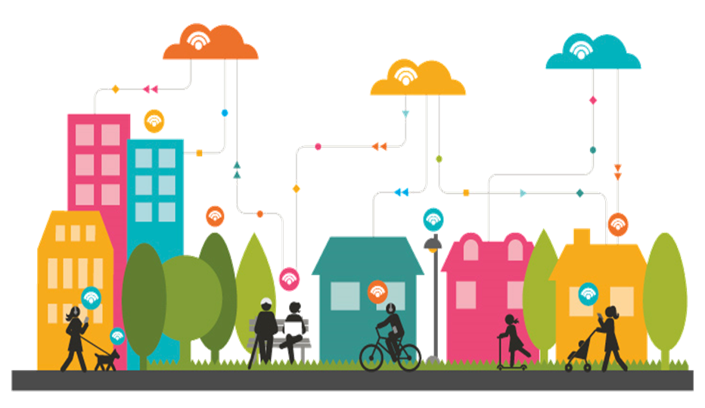

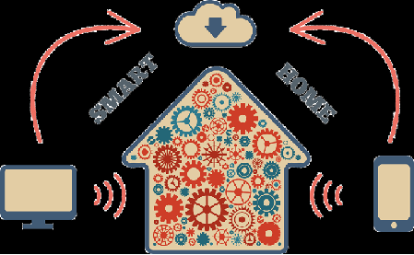

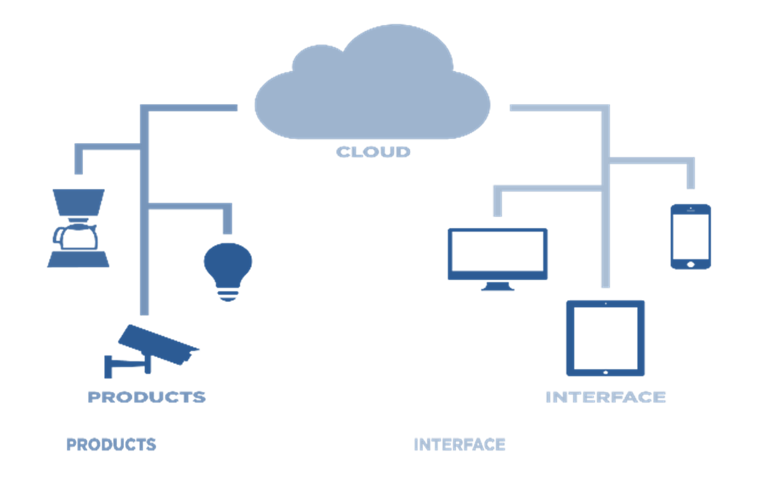
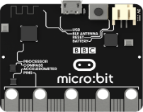
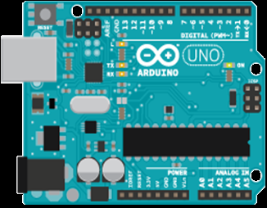
The Internet of Things
Smart City
SMART
HOME
Smart Appliances

Slide 6
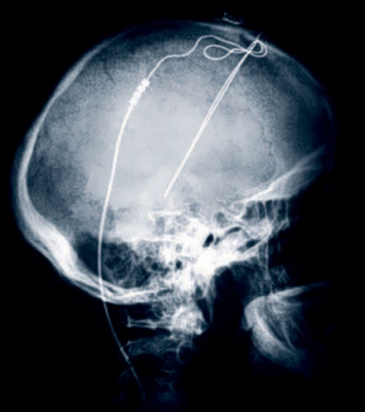
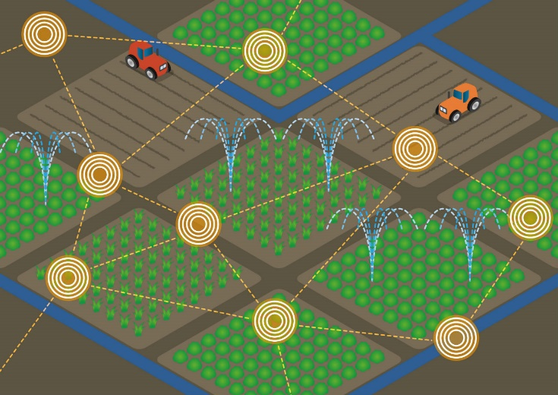
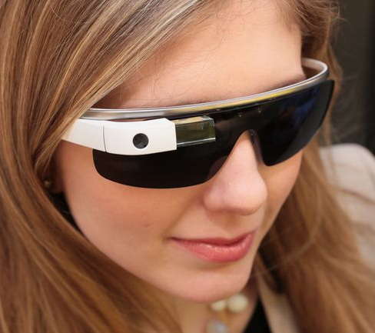

Intelligent IoT Devices
Intelligent IoT devices can help deal with latency, bandwidth, privacy and energy concerns
Low latency brain implants
Smart agriculture for disconnected farms
Privacy preserving smart glasses
Energy efficient smart forks

Slide 7


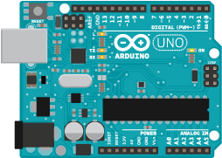
Algorithms for the IDE – Objectives
To build a library of machine learning algorithms
Which can be trained on the cloud
But which will run on tiny IoT devices
Arduino Uno

Slide 8

Trees

Slide 9
Advantages of Tree Based Learning
Trees are general and can be used for
Binary & multi-class classification
Multi-label learning
Regression
Ranking
…
Balanced trees have logarithmic prediction times
Efficient prediction in milliseconds
Lower energy consumption leading to longer lasting batteries

Slide 10
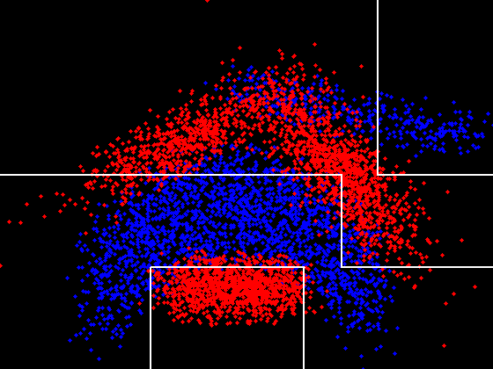
Disadvantages of Decision Trees
Shallow trees might fit in Kilobytes but might not be accurate

Slide 11
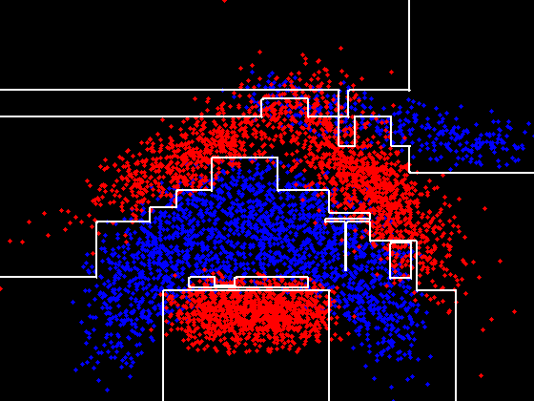
Disadvantages of Decision Trees
Deep trees might not fit in Kilobytes and might not be accurate

Slide 12
Disadvantages of Tree Ensembles
Tree ensembles hog even more memory and can only learn piecewise axis aligned decision boundaries

Slide 13
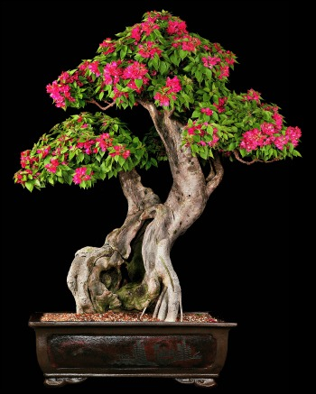
Bonsai
A Compressed Tree Model
Ashish Kumar (MSRI)
Manik Varma (MSRI)

Slide 14
Bonsai – Key Ideas
We design Bonsai to be a single, shallow, sparse tree with powerful nodes for accurate prediction
We reduce model size by learning Bonsai in a low-dimensional space into which all data is projected
We jointly learn tree and projection parameters so as to maximize accuracy within the given budget

Slide 15
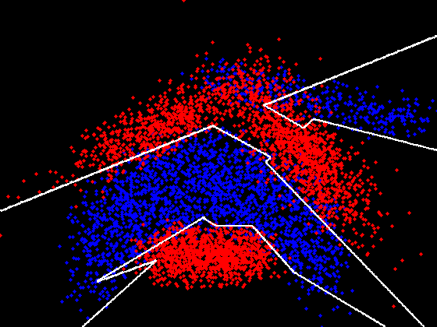

Learning Fewer But More Powerful Nodes
Bonsai learns a general linear branching function sign($θ^{t}x$) at each internal node

Slide 16
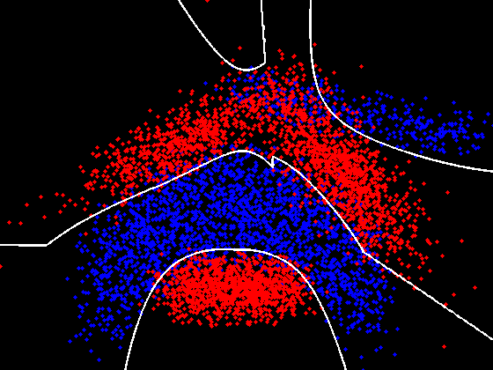

Learning Fewer But More Powerful Nodes
Each Bonsai node also makes a non-linear prediction $w^{t}x tanh\left(v^{t}x\right)$

Slide 17









Bonsai Architecture
$$w_{1}, v_{1}$$
$$θ_{1}^{t}x>0$$
Yes
No
$$x$$
$$w_{2}, v_{2}$$
$$θ_{2}^{t}x>0$$
$$w_{3}, v_{3}$$
$$θ_{3}^{t}x>0$$
Yes
No
$$\hat{y}=\left(\begin{aligned}\tanh\left(v_{1}^{t}x\right)w_{1}^{t}x \\ +\tanh\left(v_{2}^{t}x\right)w_{2}^{t}x \\ +\tanh\left(v_{4}^{t}x\right)w_{4}^{t}x\end{aligned}\right)$$
$$w_{4}, v_{4}$$
$$w_{5}, v_{5}$$
$$w_{6}, v_{6}$$
$$w_{7}, v_{7}$$

Slide 18





Bonsai Architecture
$$w_{1}, v_{1}$$
$$θ_{1}^{t}\hat{x}>0$$
Sparse Projection
(Z)
Yes
No
$$\hat{x}$$
$$x$$
$$w_{2}, v_{2}$$
$$θ_{2}^{t}\hat{x}>0$$
$$w_{3}, v_{3}$$
$$θ_{3}^{t}\hat{x}>0$$
Yes
No
$$\hat{y}=\left(\begin{aligned}\tanh\left(v_{1}^{t}\hat{x}\right)w_{1}^{t}\hat{x} \\ +\tanh\left(v_{2}^{t}\hat{x}\right)w_{2}^{t}\hat{x} \\ +\tanh\left(v_{4}^{t}\hat{x}\right)w_{4}^{t}\hat{x}\end{aligned}\right)$$
$$w_{4}, v_{4}$$
$$w_{5}, v_{5}$$
$$w_{6}, v_{6}$$
$$w_{7}, v_{7}$$

Slide 19








Multi-class Bonsai
$$W_{1}, V_{1}$$
$$θ_{1}^{t}\hat{x}>0$$
Sparse Projection
(Z)
Yes
No
$$\hat{x}$$
$$x$$
$$W_{2}, V_{2}$$
$$θ_{2}^{t}\hat{x}>0$$
$$W_{3}, V_{3}$$
$$θ_{3}^{t}\hat{x}>0$$
Yes
No
$$\hat{y}=\left(\begin{aligned}\tanh\left(V_{1}^{t}\hat{x}\right)W_{1}^{t}\hat{x} \\ +\tanh\left(V_{2}^{t}\hat{x}\right)W_{2}^{t}\hat{x} \\ +\tanh\left(V_{4}^{t}\hat{x}\right)W_{4}^{t}\hat{x}\end{aligned}\right)$$
$$W_{4}, V_{4}$$
$$W_{5}, V_{5}$$
$$W_{6}, V_{6}$$
$$W_{7}, V_{7}$$

Slide 20

The Bonsai Objective Function
$${Min}_{Θ,Z} P = \frac{λ}{2}Tr\left(ΘZZ^{t}Θ^{t}\right)+ \frac{1}{N}\sum_{i=1}^{N}{𝓛(x_{i},y_{i}, \hat{y_{i}};Θ,Z)}$$
$s. t. { \left|\left|Θ\right|\right|}_{0}<B, { \left|\left|Z\right|\right|}_{0}<S$,$Θ=\left[W,V,θ\right]$
The objective function is suitable for general loss functions $𝓛$which can be optimized via SGD
We place explicit budget constraints on the tree parameters $Θ$and sparse projection matrix $Z$ and optimize them jointly

Slide 21

Optimizing Bonsai
$${Min}_{Θ,Z} P = \frac{λ}{2}Tr\left(ΘZZ^{t}Θ^{t}\right)+ \frac{1}{N}\sum_{i=1}^{N}{𝓛(x_{i},y_{i}, \hat{y_{i}};Θ,Z)}$$
$s. t. { \left|\left|Θ\right|\right|}_{0}<B, { \left|\left|Z\right|\right|}_{0}<S$,$Θ=\left[W,V,θ\right]$
Algorithm – Repeat the following steps till convergence
Mini batch gradient descent: $K$ steps with fixed support
$$Θ_{t+1 }=Θ_{t}−η_{Θ}{\left(∇_{Θ}P\right)}_{supp\left\{Θ_{t}\right\}}$$
$$Z_{t+1}=Z_{t}−η_{z}{\left(∇_{Z}P\right)}_{supp\{Z_{t}\}}$$
Hard thresholding step
$$Θ_{t+1 }=H_{B}\left(Θ_{t} −η_{Θ}∇_{Θ}P\right)$$
$$Z_{t+1 }=H_{K}\left(Z_{t} −η_{Z}∇_{Z}P\right)$$
%

Slide 22

ProtoNN
A Compressed k-Nearest Neighbor Model
Ankit Goyal (Michigan), Chirag Gupta (MSRI), Bhargavi Paranjape (MSRI), Harsha Simhadri (MSRI), Arun Suggala (CMU), Raghavendra Udupa (MSRI), Prateek Jain (MSRI)

Slide 23
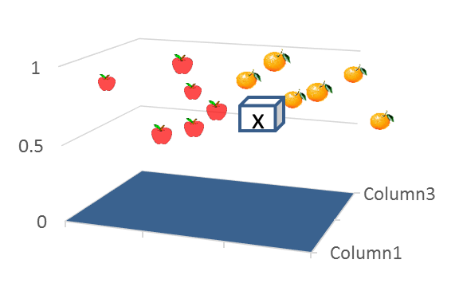
ProtoNN: Compressed kNN
kNN
$y(x)=y_{i}, i:closest point to x$
Pros:
General supervised learning algorithm
Easy to understand, debug
Works with small amount of data, no training

Slide 24
kNN for IoT
Challenges:
Poor accuracy: how to compute “distance”
Large model size: entire training data
Large prediction time
ProtoNN: Compressed kNN Algorithm
Designed to overcome the challenges in kNN
Produces models that fit on smallest IoT devices
State-of-the-art accuracy with real-time predictions

Slide 25





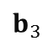
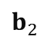
ProtoNN: Training Algorithm
Sparse
Projection
Two key ideas:
Sparse projection: reduce dimensionality+learn good distance metric
Learn prototypes: reduce model size, prediction time
Prototypes
Parameters to learn:
Z$:$Projection Matrix
$b_{1},…, b_{m}$: prototypes
$w_{1},…, w_{m}$: label vector for each prototype
$$b_{1}$$
$$b_{2}$$
$$b_{3}$$

Slide 26
ProtoNN: Training
Learn all the parameters jointly
Learn with an explicit model size constraint
Loss function: dependent on task
$$\min_{Z, b_{1},., b_{m}, z_{1},.,z_{m}}{ \sum_{i=1}{ℓ(y_{i}, \hat{y_{i}})}} \\ s.t. \hat{y_{i}}=\sum_{j}{w_{j}exp⁡(−γ||b_{j}−Zx_{i}||_{2}^{2})} \\ ||\left[w_{1},…, w_{m}\right]||_{0}≤k_{w} \\ ||Z||_{0}≤k_{Z} \\ ||\left[b_{1},…, b_{m}\right]||_{0}≤k_{b}$$
Memory Constraint

Slide 27
Optimization Algorithm
Algorithm: Hard Thresholding with SGD
Outer Loop
Inner Loop
(Z, B, W) ← SGD Update using loss function over random batch of points
Z ← Hard thresholding (make entries below a threshold to be 0)
B ← Hard thresholding
W ← Hard Thresholding
Hard Thresholding: provided analysis for a general class of problems in Jain, Tewari, Kar’NIPS-2014

Slide 28
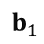


ProtoNN: Prediction Algorithm
x
Sparse
Projection
$$b_{1}$$
$$b_{2}$$
x
$$b_{3}$$
Prediction
$$y(\hat{x})=\sum_{i=1}^{m}{w_{i} e^{−{\left\|b_{i}−Zx\right\|}_{2}^{2}}⁡}$$

Slide 29
Results: Bonsai and ProtoNN
Comparison to Uncompressed Methods
Comparison to Compressed Methods
Prediction Costs on the Arduino Uno

Slide 30
Dataset Statistics
Dataset | # of Training Points | # of Test Points | # of Dimensions | # of Labels
Bird | 335 | 224 | 7,734 | 35
WARD | 4,503 | 1,931 | 1,000 | 13
RT Whale | 5,265 | 5,264 | 2,000 | 2
Character | 4,397 | 1,886 | 400 | 36
Eye | 456 | 196 | 8,192 | 2
USPS | 7,291 | 2,007 | 256 | 10
MNIST | 60,000 | 10,000 | 784 | 10
CIFAR-10 | 50,000 | 10,000 | 400 | 10

Slide 31
Comparison to Uncompressed Methods
Compressed :
Bonsai:
2KB
16KB
ProtoNN:
2KB
16KB
Uncompressed :
GBDT
kNN
RBF-SVM
Neural Nets

Slide 32
Prediction Costs on the Arduino Uno

Slide 33
Prediction Costs on the Arduino Uno

Slide 34
Prediction Accuracy vs Model Size

Slide 35
Prediction Accuracy vs Model Size

Slide 36
Bing L3/L4 Ranker Results

Slide 37
Conclusions
ML for IoT devices might provide many high-impact opportunities
The Intelligent Devices Expedition plans to develop an ML library and compiler for IoT devices
Bonsai & ProtoNN
Fit into a few Kilobytes of memory
Make predictions in milliseconds
Are energy efficient & extend battery life
Have state-of-the-art prediction accuracies

Slide 38
Appendix

Slide 39

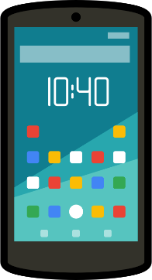
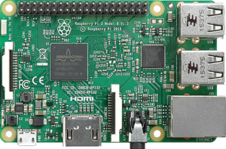
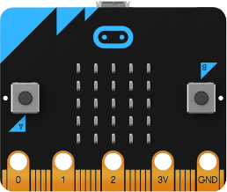
Algorithms for the IDE – Objectives
To build a library of machine learning algorithms that can run on resource constrained IoT devices
Smartphone
Raspberry
Pi
Micro:Bit
Arduino

Slide 40
Objectives – Phase 1
To build a library of machine learning algorithms that can run on resource constrained IoT devices
In cloud training
+ on device
prediction
1

Slide 41
Objectives – Phase 2
To build a library of machine learning algorithms that can run on resource constrained IoT devices
2
Cloud-device
arbitrage

Slide 42
Objectives – Phase 3
To build a library of machine learning algorithms that can run on resource constrained IoT devices
3
On device
training

Slide 43
Objectives – Phase 1
In cloud training + on device prediction
8 bit processor at 16 MHz
No Floating Point Unit
32 KB read only Flash
2 KB RAM
Arduino Uno

Slide 44
Tree Ensembles
Gradient Boosted Decision Trees (FastRank)
Random Forest

Slide 45





Bonsai – A Single, Short, Sparse Tree
Yes
No
$$x$$
. . .
$$=$$
$1$
$$+$$
$$0$$
Yes
No
$$=$$
½
$$+$$
½
. . .
. . .
. . .

Slide 46







Bonsai – A Single, Short, Sparse Tree
$$(1,0)$$
Yes
No
$$x$$
$$(0,1)$$
. . .
$1 0$
$$=$$
½ ½
Yes
No
. . .
. . .
$$(1,0)$$
. . .
. . .
(½,½)
$$\hat{Θ}$$
$$Θ$$
$$Z$$

Slide 47


Bonsai – A Single, Short, Sparse Tree
$$(1,0)$$
Yes
No
$$x$$
$$(0,1)$$
. . .
$$\hat{Θ}$$
=
$$Θ$$
Yes
No
Sparse
Dictionary Z
$$(1,0)$$
. . .
. . .
(½,½)

Slide 48

Bonsai – A Single, Short, Sparse Tree
$$(1,0)$$
Streaming
Projection Z
Yes
No
$$\hat{x}$$
$$x$$
$$(0,1)$$
. . .
Yes
No
$$\hat{y}=\left(\begin{aligned}\tanh\left(v_{1}^{t}\hat{x}\right)w_{1}^{t}\hat{x} \\ +\tanh\left(v_{2}^{t}\hat{x}\right)w_{2}^{t}\hat{x} \\ +\tanh\left(v_{4}^{t}\hat{x}\right)w_{4}^{t}\hat{x}\end{aligned}\right)$$
$$(1,0)$$
. . .
. . .
(½,½)

Slide 49
Bonsai & ProtoNN
Resource Constrained Algorithms for Efficient Classification, Regression & Ranking

Slide 50
Bonsai and ProtoNN
Learn models specifically tailored to fit in Kilobytes of RAM rather than compressing existing models
Sparsely project datapoints into a low-dimensional subspace to reduce model size
Jointly learn the sparse projection and model parameters to optimally utilize budget and maximize accuracy
Can deliver almost the same accuracy as models that take up to a GB of RAM
Make predictions in milliseconds using millijoules of energy

Slide 51
Prediction on loT Devices
Might be preferable in scenarios with concerns about bandwidth, latency & privacy/security
Seeing AI, HAMS, Jubilee, Agrikites, etc.
Might be of interest to device manufacturers
Cheaper devices, smaller form factors, longer battery life, etc.
Might be of interested to cloud providers
Differentiating ML services: ML on the edge, data throttling, etc.

Slide 52
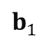


ProtoNN
x
Sparse
Projection
x
Prototypes
$$y(\hat{x})=\sum_{i=1}^{m}{y_{i} e^{−{\left\|b_{i}−\hat{x}\right\|}_{2}^{2}}⁡}$$
Prediction
$$b_{1}$$
$$b_{2}$$
x

Slide 53
Benchmarking Existing ML Algorithms
Gradient Boosted Decision Trees [Friedman et al. Ann Stat 01]
Tree Ensemble Pruning [Dekel et al.]
Neural Network Pruning [Han et al. ICLR 16]
Decision Jungles [Shotton et al. NIPS 13]
Local Deep Kernel Learning [Jose et al. ICML 13]
Stochastic Neighbor Compression [Kusner et al. ICML 14]
Feature-Budgeted Random Forest [Nan et al. ICML 15]

Slide 54
Benchmarking Existing ML Algorithms

Slide 55
Wearable Activity Recognition Dataset
Neural Nets and Boosted Trees do not dominate
There is significant room for improvement

Slide 56
Wearable Activity Recognition Dataset

Slide 57
Character Recognition
Neural Nets and Boosted Trees do not dominate
There is significant room for improvement

Slide 58
Character Recognition

Slide 59
Recognizing Bird Species in the Wild
Neural Nets and Boosted Trees do not dominate
There is significant room for improvement

Slide 60
Recognizing Bird Species in the Wild

Slide 61
Comparison to Uncompressed Methods
16KB :
Bonsai
ProtoNN
Uncompressed :
GBDT
kNN
RBF-SVM
Neural Nets

Slide 62
Maximum Accuracies in 0 – 2 KB

Slide 63
Prediction Time on the Arduino Uno

Slide 64
Energy Consumed on the Arduino Uno

Slide 65
Future Work
Develop new ML algorithms
Anomaly detection & Gaussian Mixture Models
Deep learning
Predictive maintenance
Efficient implementation on device
Microprofile SRAM, Flash, Processor, Sensors, …
Optimize code for CPU/RAM utilization & battery life
Domain specific language compiler optimization
Apply our algorithms to other ML problems on a budget
Bing: L3/L4 re-ranker
One Protection: Virus and malware classifier

Slide 66

ProtoNN Demo on the Arduino Uno
Berkeley Wearable Activity Recognition Dataset
13 activities: Jog, Jump, Push, Sit, Walk, …
5 on-body gyroscopes & accelerometers
Raw signals sent from the laptop to the Uno
Time series features extracted on the Uno
ProtoNN prediction carried out on the Uno
Dataset: WARD | ProtoNN | kNN | GBDT | Neural Nets | RBF-SVM
Accuracy (%) | 89.2 | 77.97 | 93.15 | 81.25 | 87.2
Model Size (KB) | 22 | 32900 | 6193 | 395 | 17367
Prediction Time (ms) | 685

Slide 67
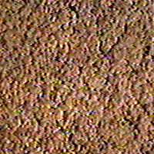
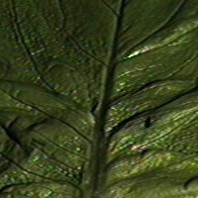
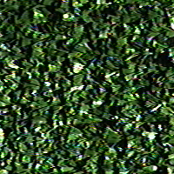

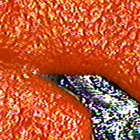


Bonsai Demo on the Arduino Uno
Columbia-Utrecht Material Recognition Dataset
61 Materials: Glass, Grass, Paper, Pebbles, Wood, …
Pre-computed visual features streamed from the laptop
Bonsai prediction carried out on the Uno
Dataset: CUReT | Bonsai | kNN | GBDT | Neural Nets | RBF-SVM
Accuracy (%) | 93.22 | 86.74 | 86.53 | 95.51 | 95.1
Model Size (KB) | 16.8 | 6850 | 3574 | 1310 | 6953
Prediction Time (ms)

